Slide 1


File Management
www.tpfsoftware.com

Slide 2
File Management
Introduction to File Management
z/TPF Online Database
Accessing a File
Updating files
z/TPF Stream File system Support

Slide 3
Introduction to File Management
zTPF supports two types of secondary storage devices:
Direct Access Storage Device (DASD)
(Magnetic) Tapes
All the online databases in zTPF are maintained in the DASD.
The online database of the zTPF system is allocated at system generation time and is shared by all entries and all applications
Fixed file storage.
Pool file storage.
Magnetic tapes are used for online and offline processing and can be used for both input and output in the z/TPF system.
General files and general data sets are usually related to some offline processing. Data is either produced online to be processed offline by z/OS® programs or data is produced offline for online processing. Both structures provide a data interface between the offline and online system components.

Slide 4
z/TPF Online Database
The online database is the main database in the z/TPF system and its organization of data is unique to the z/TPF system
Data is stored and retrieved at the physical record level. The records can be classified according to the following sizes:
Small (381 bytes)
Large (1055 bytes)
4K (4095 bytes).
z/TPF files are allocated across the range of physical storage media to balance and, therefore, improve access performance. Therefore, successively numbered records are allocated to different physical direct access storage devices (DASD).

Slide 5
z/TPF Online Database
The structure of the online data is identified during system generation. Data is dynamically generated; however, the facilities for storing the data are identified prior to the online operation.
When a DASD is installed, it is formatted to define the number of each category of record to be stored.
Each record in the system is physically identified in the DASD using a Module number, Cylinder number, Head number and a Record number (MCHR).
This information is encoded in symbolic form referred to as ‘File Address’.

Slide 6
Fixed File
Fixed records form a static repository of data records, such as indexes to more dynamic data
A set of records within a fixed record area is identified as a fixed record type; a record type is the name of a set of records.
Within a fixed record type, each record is identified with a record type ordinal number; the ordinal numbers are viewed logically, by an application, as sequential record numbers but are not sequentially allocated to physical storage.
A fixed file is used when the number of records required is relatively constant and the records are frequently accessed.

Slide 7
Fixed File
A record in fixed file storage is used for a specific purpose.
An application program references a record in fixed file storage through the use of a record type (which is a value) and ordinal number (a relative number of a record within a specified record type). The z/TPF system translates this reference into a symbolic address.
A program called FACE is used to convert the record type and ordinal number into a symbolic file address.
A miscellaneous file is a type of fixed file. The database administrator normally defines some miscellaneous fixed files on DASD with record types #MISCS, #MISCL, and #MISC4. The last character in the name identifies the size used for prime blocks in the subfile.

Slide 8
Pool File
The dynamic requirements for file storage are satisfied by the use of areas on modules known as pools.
Several pool record types are defined by the system, based upon record attributes in order to allocate pool areas on modules.
The records in pool file storage, or just pool, are dispensed as needed and returned to the system when they are no longer needed and can be re-dispensed.
When a pool record is requested by an application program, the system locates an available record and returns a pointer (address) to the pool record; typically the pointer is saved in a fixed file record for subsequent reference.
They are dispensed on a need basis. When requested, the system allocates an available file from a pool and returns the symbolic file address to the application.

Slide 9
Pool File
The pool files are classified into two categories based on its life time:
Long term pool file
Short term pool file
The long term pool files are used to store data of permanent nature.
They are released back to the system only when the application requests for it.
Typically, the address of a long term file is stored in a fixed file for subsequent reference.
The Short term pool file is used to store data of temporary nature.
The system automatically recycles them without any consideration, if does not have any to dispense. Therefore it has to be used with caution.

Slide 10
Illustration of a Cardmember Database – Fixed and Pool Files
For instance, to develop a database that maintains the relation between cardmember name and the details of each customer, a fixed file with 26 ordinals can be used. Record type (in this case, #INDEX) and ordinal numbers (0 through 25).
In order to retrieve (that is, to find or read) a pool record, the application must know its address. The most common technique used by applications is to form data structures that use fixed records as indexes to pool records.
The index, a fixed file record is retrieved by using the first letter of the last name of the cardmember name to calculate the address of the appropriate index record. The index is then scanned for the name, and, when that item is found, the associated customer detail file embedded in that item, which is a pool address is accessed. This allows the selection of one of a vast number of pool records with a minimum of file accesses (that is, I/O operations)

Slide 11
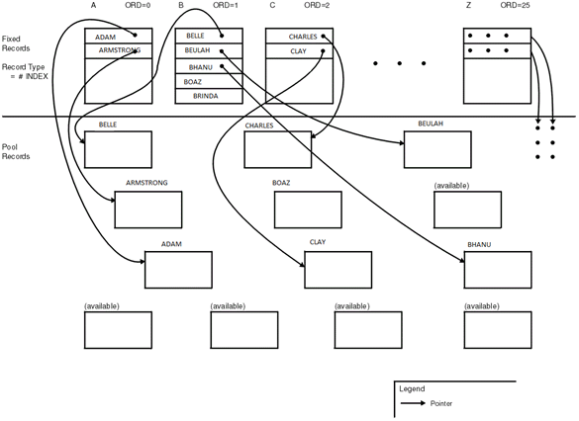
Illustration of a Cardmember Database – Fixed and Pool Files
Below Diagram illustrates the above mentioned point.

Slide 12
Illustration of a Cardmember Database – Fixed and Pool Files
Let us say an ordinal(“S”) does not have enough space to accommodate a new name, a pool file is requested and the new information is stored in the pool file.
The pool file is then chained to the ordinal (a fixed file). The fixed file is called the prime and the chained pool file(s) are called as overflows.

Slide 13
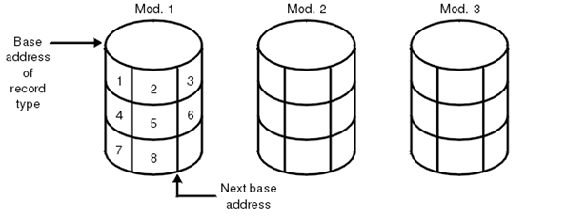
Horizontal Database Allocation
Vertical Database Allocation: Records in general file or general data set are contained on one physical storage medium and are allocated in a sequential fashion similar to a conventional z/OS sequential data set.

Slide 14
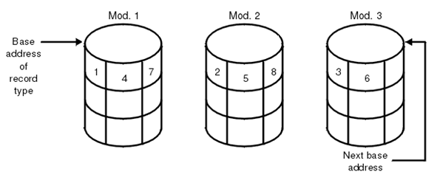
Horizontal Database Allocation
Horizontal Database Allocation: The organization of data in the online z/TPF system is unique to the z/TPF system. z/TPF files are allocated across the range of physical storage media to balance and, therefore, improve access performance. Therefore, successively numbered records are allocated to different physical direct access storage devices (DASD).

Slide 15
DBON and physical address
The z/TPF system views the entire file space as a repository for holding 4K, 1055-byte and 381-byte records
Within a given record type (for example, 4K fixed records), the z/TPF system has several database ordinal numbers (DBON)
Consider the representation of the fixed file space of n records (database ordinal numbers 0 through n-1). The number of record types is given as m, where m is less than n.
To allocate fixed file space means dividing the entire fixed file space into subgroups of record types, where a subgroup consists of either all small, all large, or all 4K fixed records. The allocation is accomplished by creating a FACE table that associates the base address, called a beginning database ordinal number (DBON), with each record type. For example, in the below diagram, record type 1 begins at DBON 6 and four records are allocated to record type 1. The next record type (record type 2) begins at DBON 10. In general, each record type is associated with some unique DBON.

Slide 16
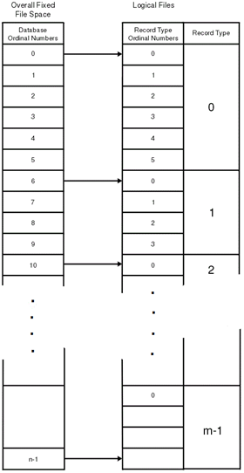
DBON and physical address

Slide 17
DBON and physical address
A fixed file area for holding record types consisting of records of the same size has a set of database ordinal numbers (0 through n-1).
Each fixed record type has a set of DBONs equal to the number of records designated for that record type.
There is a similar procedure for allocating the pool file space. The record type for a pool file is based on the pool record type (such as SSTx and LDPx).
The online physical file storage is allocated for the different record sizes in proportions that are primarily determined by application design. The sum of allocations of all pool and fixed records comprises the entire online physical file space.

Slide 18
DBON and physical address
The z/TPF system ensures that the sequential database ordinal numbers (DBON) do not map into physically adjacent records. It is assumed, in general, that the horizontal allocation of records of a given record type throughout the file storage permits a greater chance for simultaneous accessing than the more conventional, vertical allocation,
The allocation of records associates successive database ordinal numbers (DBON) with successive modules, cylinders, heads, and records on modules.

Slide 19
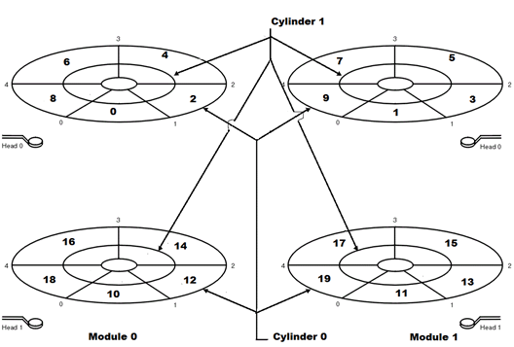
DBON and physical address
Consider the below example that shows a configuration of two modules, two cylinders, two heads per module, and five records per track. The numbers in bold and larger font size represent database ordinal numbers (DBON). The numbers in smaller font size represent the device addresses, that is, the names of physical locations.

Slide 20
Record Duplication
In the z/TPF system, data records (on modules) can be duplicated, which means that there are two copies of a data record on the database. The copies are referred to as the primary record and the backup record, sometimes called the duplicate record or dupe
Record duplication addresses the design objectives of the z/TPF system of:
Performance
Database integrity
by providing the ability to maintain two copies of critical data records.

Slide 21
Record Duplication
Primary and backup records must be allocated to the same device type. Allocation of fixed and pool data can be specified as:
Non-duplicated - None of the records are duplicated on the device type
Selectively duplicated - Selected (critical) records are duplicated on the device type
Fully duplicated - All records (fixed and pool) are duplicated on all of the device types generated in the user installation.
The allocation procedure assigns two database ordinal numbers (DBONs) to a duplicated record, each to different modules.
The duplicate record in a record type (either pool or fixed) is assigned to the same relative position on an alternate disk module. Therefore, an even number of modules is required.

Slide 22
Multiple Database function (MDBF)
The multiple database function (MDBF) provides the user with the ability to:
Physically separate sets of data
Logically separate sets of data
Physically and logically separate sets of data.
The use of MDBF introduces the concepts of subsystems and subsystem users.
In the following diagram the Subsystem provides a physical separation of data, while a Subsystem user provides a logical separation of data.

Slide 23
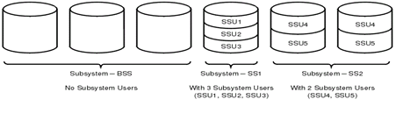
Multiple Database function (MDBF)

Slide 24
Data Record Attributes
Physical residence: the physical location of a record is transparent to the application environment. The z/TPF system manages the following physical forms of storage on which data records can reside – Modules, Magnetic tape, Main Storage.
Device Type: The z/TPF system supports four device types (DEVA, DEVB, DEVC, and DEVD). Each of these device types represents distinct characteristics for accessing and managing the location of data on the online DASD subsystem. Data is mapped across the DASD subsystem based on the several factors, including:
Relative starting module number
Number of modules defined for the device
Number of records per track
Number of tracks per cylinder
Number of cylinders per module
Module duplication factor (simples or duplex)
Physical record sizes; that is, small (381 bytes), large (1055 bytes), 4 KB (4096 bytes).

Slide 25
Data Record Attributes
Record Size: The logical size of a record within the z/TPF system is always one of three sizes: small (381 bytes), large (1055 bytes), 4 KB (4096 bytes).
Record Duplication: In the z/TPF system, data records (on modules) can be duplicated, which means that there are two copies of a data record on the database. The copies are referred to as the primary record and the backup record, sometimes called the duplicate record or dupe
Record Longevity: By definition, fixed records are maintained by the z/TPF system forever while pool records are maintained for an interval of time, which is determined by the application environment (in terms of seconds, hours, days, weeks, or months). There are short term pool records and long term pool records.

Slide 26
Data Record Attributes
Pool record types: Pool records are classified according to the attributes of size, duplication, longevity, and residence (type of device). The basic pool types are:
Small short-term pool (SSTx)
Small long-term (not duplicated) pool (SLTx)
Small long-term duplicated pool (SDPx)
Large short-term pool (LSTx)
Large long-term (not duplicated) pool (LLTx)
Large long-term duplicated pool (LDPx)
4K short-term pool (4STx)
4K long-term (not duplicated) pool (4LTx)
4K long-term duplicated pool (4DPx)
4K long-term duplicated FARF6 pool (4D6)

Slide 27
Data Record Attributes
Types of Fixed file records: Fixed file records can be classified according to the following sizes:
Small (381 bytes)
Large (1055 bytes)
4K (4095 bytes).

Slide 28
File Address Compute Table (FCTB)
The file address compute (FACE) table (FCTB), a system table, is a centralized source of information about file addresses. It provides the information necessary to do the following:
Convert a record type and ordinal number into a file addressing scheme called file address reference format (FARF). This conversion applies to both fixed-file records and pool records.
Convert a FARF address into its physical record address in module cylinder head record (MCHR) format.
For fixed addresses, the FACE table is accessed by the FACE and FACS programs and the FAC8C and FACZC macro service routines.
For pool addresses, the FCTB is accessed by the Get File Storage macro service routines.

Slide 29
File Address Reference Format (FARW)
The file address reference format is the method used by the z/TPF system to symbolically address fixed and pool records.
The 4-byte file address defined by FARF is a basic element of data organization in the z/TPF system.
There are four file address reference formats: FARF3, FARF4, FARF5, and FARF6. These allow the z/TPF system the flexibility of adapting to module technology.

Slide 30
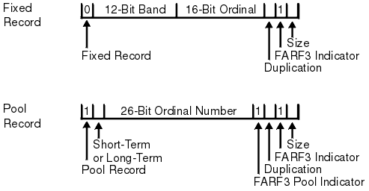
File Address Reference Format (FARW)
FARF3

Slide 31
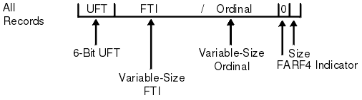
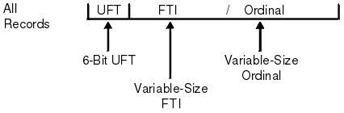
File Address Reference Format (FARW)
FARF4
FARF5

Slide 32
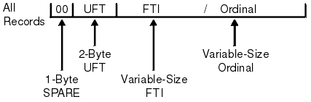
File Address Reference Format (FARW)
FARF6

Slide 33
z/TPF Standard Record Header
Each file in the system has a standard header before the data section.
The standard header is 8-bytes long and following are the contents:
Record ID | 2 bytes
Record code check | 1 byte
Control byte | 1 byte
Program stamp | 4 bytes

Slide 34
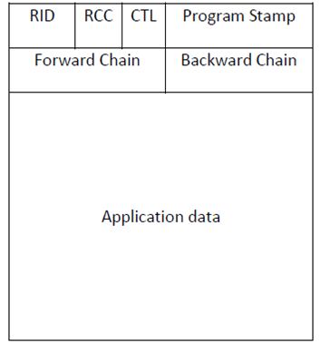
z/TPF Standard Record Header
Optionally, the forward and back ward chain (4 bytes each) are also maintained in some records.

Slide 35
z/TPF Standard Record Header
Every unique file in the system, fixed or pool, is associated with a 2-byte record ID.
The record ID describes the characteristics of the record such as size, longevity, VFA candidacy etc.
These characteristics are maintained in the zTPF system in a table called the Record ID attribute table (RIAT).
The Record code check (RCC) is a 1-byte value generated and stored by an application program. It is used to ensure and validate the integrity of the database.

Slide 36
z/TPF Standard Record Header
The Control byte, If used, will have the following set:
The Program stamp is the last program that updated the record.
Bit 0 = 1 | Forward chaining is applicable
Bit 1 = 1 | Backward chaining is applicable
Bit 2 = 1 | L2 Record
Bit 4 = 1 | Overflow record

Slide 37
Record ID Attribute Table (RIAT)
There is one item in the RIAT for each record ID defined within any subsystem, and there is a RIAT for each subsystem
The attribute information for each ID consists of the following data:
Record category (0–9)
Exception recording, logging, and restoring data
User exit data
VFA candidacy and delay file threshold
Record caching candidacy
Lock maintenance in a loosely coupled environment.

Slide 38
Accessing a File
An ECB has to fetches a file in to the main memory from the DASD in order to access it.
To retrieve a file, the zTPF system needs to be provided with the symbolic file address of the same.
A fixed file is uniquely identified using its record type and ordinal number.

Slide 39
Fixed File Access
The steps involved are as below for a fixed file:
Step 1 - Obtain the symbolic file address.
This is done using the FACE program which access the File address Compute Table (FCTB). The FCTB contains information to convert a record type and ordinal number to the corresponding symbolic addresses and from that to a physical address in MCHR.
The inputs to the FACE program are:
R6 should contain the record type
R7 should contain the FARW address of the data level where file is to be fetched.
R0 should contain the ordinal number.
FACE program when successful, returns the file adder ss on the FARW of the passed level and the highest ordinal number for the file type on Register R0.
If FACE fails, then Register R0 will be zero.

Slide 40
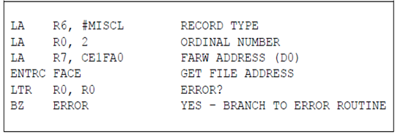
Fixed File Access
Following is an example, to access ordinal 2 of a fixed file with record type #MISCL.

Slide 41
Fixed File Access
Step 2 - Once the file address is obtained, the record ID and record code check have to be populated in the specified data level whose FARW contains the file address.
Step 3 - The final step is to issue one of the FIND type macros to retrieve the file from DASD to the core.
The FIND macro causes the ECB to be suspended for a while until I/O completes.
Hence it is advisable to always code a WAITC macro after issuing a FIND macro.
On successful I/O completion, the requested File contents are copied on to a core block which is then attached to the CBRW of the specified Data level.

Slide 42
Fixed File Access
If unsuccessful the following bits are set in the ECB fields CE1SUG/CE1SUD.
Bit 0 = 1 | I/O Hardware Error
Bit 1 = 1 | Record ID Check Failure
Bit 2 = 1 | RCC Check Failure
Bit 6 = 1 | Invalid File Address

Slide 43
Pool File Access
To access a Pool file, the application needs to know the address of the file in advance.
The file address must be populated on the FARW of the data level where file is to be fetched on.
Then step 2 and 3 of the fixed file retrieval should be followed.

Slide 44
Record ID and RCC checks during File access
The record ID and RCC are used to validate the integrity of a record.
In a FIND type macro, the validation is performed by the control program as follows:
RID in FARW | Is Non-zero | The RID in FARW is compared in the header of the retrieved file. If the comparison fails, appropriate error bits are set in CE1SUD/CE1SUG fields of the ECB and the processing continues.
 | Is zero | No validation is Performed
RCC in FARW | Is Non-zero | The RCC in FARW is compared in the header of the retrieved file. If the comparison fails, appropriate error bits are set in CE1SUD/CE1SUG fields of the ECB and the processing continues.
 | Is zero | No validation is Performed

Slide 45
Updating a File
In zTPF, a file can be updated by multiple ECBs at the same time.
Hence, if there is no synchronization between the ECBs accessing a file, the updates made by one ECB might be over written by the other, leading the in- consistency of data.
Following is a typical problem illustration of the phenomenon described above.

Slide 46
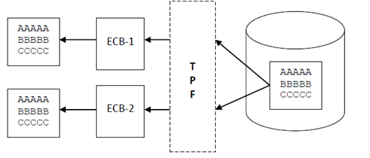
Problem Illustration
ECB-1 and ECB-2 request for the same record simultaneously. The I/O request is serviced and both the ECBs are given a copy of the record in the core.

Slide 47
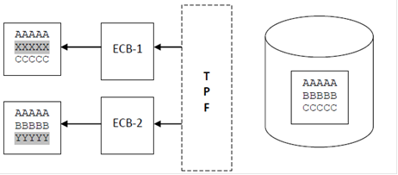
Problem Illustration
ECB-1 and ECB-2 make their necessary updates ( as highlighted) to the copies obtained by them.

Slide 48
Problem Illustration
ECB-1 initiates a request to file its changes to the DASD.

Slide 49
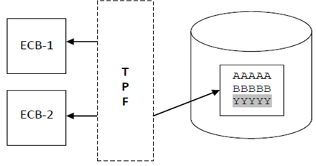
Problem Illustration
ECB -2 initiates a request to file its changes to the DASD.
It is now evident that ECB-2 Clearly overwrites the updates of ECB-1, which leads to inconsistency of data!

Slide 50
Solution
zTPF provides the HOLD mechanism to avoid such problem situations.
The HOLD provides exclusive access to a requesting ECB. All the requests for updating the same file by other ECBs are queued.
A record that needs to be updated must be requested with a HOLD.
When an application is done updating the file, it must use one of the FILE macros to file the changes to the DASD (or VFA) and also release the HOLD on the record.
This allows the next ECB waiting on queue to get access to the file.
By principle, only the prime file is requested with HOLD.

Slide 51
Deadlock
the HOLD mechanism might cause a deadlock situation.
For instance, say ECB-1 which is holding a File B, tries to hold File A which is held by ECB-2 and ECB-2 is waiting to hold File B to release File A.
To avoid such a situation, the application must be written in such a way that:
No more than one record is on hold at any given time.
The hold is not maintained for a time longer than needed, i.e. The hold must be withdrawn soon after the updates are complete.

Slide 52
Record ID and RCC checks during File update
The record ID and RCC are used to validate the integrity of a record.
In a FILE type macro, the validation is performed by the control program as follows:
RID in FARW | Is Non-zero | The RID in FARW is compared in the header of the retrieved file. If the comparison fails, a system error is generated and the ECB exits.
 | Is zero | Not Allowed. RID must always be supplied for FILE macro.
RCC in FARW | Is Non-zero | The RCC in FARW is compared in the header of the retrieved file. If the comparison fails, a system error is generated and the ECB exits.
 | Is zero | No validation is Performed

Slide 53
File management macros – FINDC
FINDC – Find a File
FINDC reads a file into the core based on the parameters specified in the FARW of the provided data level.
Syntax:
Assembler:
FINDC Dn
C:
void findc(enum t_lvl level);
Dn | Specifies the data level (D0-DF) on which the core block has to be assigned.
level | One of 16 possible values representing a valid data level from the enumeration type t_lvl, expressed as Dx, where x represents the hexadecimal number of the level (0–F). The data record being retrieved is attached to this level.

Slide 54
File management macros – FINDC
Other variants in C:
Entry Conditions:
The core block must not be present in the specified level.
A file address, RID and RCC must be contained in the FARW for the specified data level.
Return Conditions:
Assembler:
The specified data level will hold a core block.
Register R14, R15 contents are unknown and other registers are preserved across this macro call.
C:
Void
void | findc_ext(enum t_lvl level,unsigned int ext);

Slide 55
File management macros – FINDC
Exception:
Programming Consideration:
WAITC should be coded to ensure ECB processing waits until I/O operation is complete.
CTL- 22 | FIND issued on data level already holding a block.
CTL- 2D | Zero File Address

Slide 56
File management macros – FINDC
Example:
Assembler:
FINDC D2 Finds file and puts Core block on level 2.
WAITC FINDERR Wait for I/O to complete.
C:
findc(D6); Retrieves data record on level 2.
if(waitc())
{
serrc_op(SERRC_EXIT,0x12345,”I/O ERROR”,NULL);
}

Slide 57
File management macros - WAITC
WAITC – Suspending processing for I/O completion
Suspends the processing of ECB until I/O requests for the ECB have been serviced. If an error is encountered, the control is transferred to the label specified as a parameter.
Syntax:
Assembler:
WAITC labelerr
C:
int waitc(void);
Other variants in C: None
labelerr | Label of an error routine in the current program segment.

Slide 58
File management macros - WAITC
Entry Conditions: None
Return Conditions:
Assembler:
If a hardware error or unusual condition occurred, control is given to the error routine specified by labelerr.
Register R14 and register R15 contents are unknown.
All other registers are preserved over this macro call.
C:
Integer value of zero.
Integer value representing the value of CE1SUG (gross level error indicator byte).
Exception: None

Slide 59
File management macros - WAITC
Programming Consideration:
Single WAITC can be used to handle multiple I/O requests.
If no I/O is pending, there is no loss of control by the entry.
Running this macro resets the 500 ms program time-out if I/O operations are pending for this ECB.
Example:
Assembler:
WAITC FINDERR Wait for I/O to complete.
C:
if(waitc()) Wait for I/O to complete.
{
serrc_op(SERRC_EXIT,0x1234,"cannot find f/a",NULL);
}

Slide 60
File management macros - FINWC
FINWC – Find a File and wait.
Performs the operation of both FINDC and WAITC in a single macro call. Read a File into the core based on the parameters specified in the FARW of the provided data level and waits for I/O to complete.
Syntax:
Assembler:
FINWC Dn,labelerr
Dn | Specifies the data level (D0-DF) on which the core block has to be assigned.
labelerr | Label to branch to in case of error.

Slide 61
File management macros - FINWC
C:
void *finwc(enum t_lvl level);
Other variants in C:
Entry Conditions:
The core block must not be present in the specified level.
A file address, RID and RCC must be contained in the FARW for the specified data level.
void | *finwc_ext(enum t_lvl level, unsigned int ext);
void | *find_record_ext(enum t_lvl level, const unsigned int *address, const char *id, unsigned char rcc, enum t_act type, unsigned int ext);

Slide 62
File management macros - FINWC
Return Conditions:
Assembler:
The contents of CBRW are unchanged and the FARW is unchanged.
Register R14 and register R15 contents are unknown.
All other registers are preserved over this macro call.
C:
Pointer to the working storage block containing the retrieved record image.
Exception:
CTL- 22 | FIND issued on data level already holding a block.
CTL- 2D | Zero File Address

Slide 63
File management macros - FINWC
Programming Consideration:
Use FINWC instead of FINDC and WAITC.
Example:
Assembler:
FINWC D7,FINDERR Finds file and puts Core block on CE1CR7
And wait for I/O to complete.
C:
finwc(D7); Finds file and puts Core block on CE1CR7
And wait for I/O to complete.

Slide 64
File management macros - FINHC
FINHC – Find a File with hold.
Performs the operation of FINDC and assigns exclusive of the file to the requesting ECB.
The control program will queue this request if the record is being held by another ECB, if not the HOLD table is updated with ECB and File address. All succeeding requests to hold this record are queued until held record is released for update.
Syntax:
Assembler:
FINHC Dn
Dn | Specifies the data level (D0-DF) on which the file has to be retrieved with HOLD.

Slide 65
File management macros - FINHC
C:
void finhc(enum t_lvl level);
Other variants in C:
level | One of 16 possible values representing a valid data level from the enumeration type t_lvl, expressed as Dx, where x represents the hexadecimal number of the level (0–F). The data record being retrieved is attached to this level.
void | finhc_ext(enum t_lvl level, unsigned int ext);

Slide 66
File management macros - FINHC
Entry Conditions:
The core block must not be present in the specified level.
A file address, RID and RCC must be contained in the FARW for the specified data level.
The ECB must not be holding the record already
Return Conditions:
Assembler:
The contents of CBRW are unchanged and the FARW is unchanged.
On successful retrieval, CE1HLD counter is incremented by 1.
Register R14 and register R15 contents are unknown.
All other registers are preserved over this macro call.
C:
Void

Slide 67
File management macros - FINHC
Exception:
Programming Consideration:
A WAITC must follow this macro.
CTL 21 | Record hold table full ( catastrophic error).
CTL 22 | FIND issued on data level already holding a block.
CTL 2D | Zero File Address.
CTL 35 | Attempt to hold same record more than once.
CTL FC | ECB attempts to hold more than 256 macros.

Slide 68
File management macros - FINHC
Example:
Assembler:
FINHC D7 Finds file and puts Core block on CE1CR7
WAITC FINDERR And wait for I/O to complete.
C:
finhc(D7); Finds file and puts Core block on CE1CR7
if(waitc()) And wait for I/O to complete.
{
serrc_op(SERRC_EXIT,0x12345,"I/O ERROR OCCURRED",NULL);
}

Slide 69
File management macros - FIWHC
FIWHC – Find a File with hold and wait for I/O completion.
Performs the operation of FINHC and WAITC in a single macro call.
Syntax:
Assembler:
FIWHC Dn,labelerr
Dn | Specifies the data level (D0-DF) on which the file has to be retrieved with HOLD.
labelerr | Label of an error routine in the program segment.

Slide 70
File management macros - FIWHC
C:
void *fiwhc(enum t_lvl level);
Other variants in C:
level | One of 16 possible values representing a valid data level from the enumeration type t_lvl, expressed as Dx, where x represents the hexadecimal number of the level (0–F). The data record being retrieved is attached to this level.
void | *fiwhc_ext(enum t_lvl level, unsigned int ext);

Slide 71
File management macros - FIWHC
Entry Conditions:
The core block must not be present in the specified level.
A file address, RID and RCC must be contained in the FARW for the specified data level.
The ECB must not be holding the record already.
Return Conditions:
Assembler:
The contents of CBRW are unchanged and the FARW is unchanged.
On successful retrieval, CE1HLD counter is incremented by 1.
All pending I/O operations, including this request, are completed for this ECB.
Register R14 and register R15 contents are unknown.
All other registers are preserved over this macro call.
C:
Pointer to the working storage block containing the retrieved record image.

Slide 72
File management macros - FIWHC
Exception:
Programming Consideration:
Prefer FIWHC instead of FINHC and WAITC.
CTL 21 | Record hold table full ( catastrophic error).
CTL 22 | FIND issued on data level already holding a block.
CTL 2D | Zero File Address.
CTL 35 | Attempt to hold same record more than once.
CTL FC | ECB attempts to hold more than 256 macros.

Slide 73
File management macros - FIWHC
Example:
Assembler:
FIWHC D7 Finds file and puts Core block on CE1CR7 with HOLD and wait for I/O to complete.
C:
struct im0im *inm;
inm = fiwhc(D7); Finds file and puts Core block on CE1CR7 with HOLD and wait for I/O to complete.

Slide 74
File management macros - FILEC
FILEC – File a Record
FILEC writes a file working copy in core to file and releases the core block.
Syntax:
Assembler:
FILEC Dn
C:
void filec(enum t_lvl level);
Dn | Specifies the data level (D0-DF) on which the core of the file exists.
level | One of 16 possible values representing a valid data level from the enumeration type t_lvl, expressed as Dx, where x represents the hexadecimal number of the level (0–F). The working storage block on this data level is the record to be filed.

Slide 75
File management macros - FILEC
Other variants in C:
Entry Conditions:
The core block must be present in the specified level.
A file address, RID and RCC must be contained in the FARW for the specified data level
Return Conditions:
Assembler:
The specified data level will no longer hold a core block.
Register R14, R15 contents are unknown and other registers are preserved across this macro call.
void | filec_ext(enum t_lvl level,unsigned int ext);

Slide 76
File management macros - FILEC
Exception:
CTL- 23 | No block in CBRW
CTL- 2D | Zero File Address.
CTL- 2E | RID check failure.
CTL- 2F | RCC check failure.
CTL- 30 | Unable to file the record in DASD.
CTL- 32 | File block and Storage block size mismatch.

Slide 77
File management macros - FILEC
Programming Consideration:
Program stamp updated on File header.
RID on FARW cannot be Non-zero. RCC can be zero.
Example:
Assembler:
FILEC D2 Files the record in data level 2.
C:
filec(D6); Files the record in data level 6.

Slide 78
File management macros - FILNC
FILNC – File a File Record with No Release
FILNC writes a file working copy in core to file but does not releases the core block.
Syntax:
Assembler:
FILNC Dn
C:
void filnc(enum t_lvl level);
Dn | Specifies the data level (D0-DF) on which the core of the file exists.
level | One of 16 possible values representing a valid data level from the enumeration type t_lvl, expressed as Dx, where x represents the hexadecimal number of the level (0–F). The working storage block on this data level is the record to be filed.

Slide 79
File management macros - FILNC
Other variants in C:
Entry Conditions:
The core block must be present in the specified level.
A file address, RID and RCC must be contained in the FARW for the specified data level.
Return Conditions:
Assembler:
CBRW at specified level is unavailable but is made available on return from the next WAITC call.
Register R14, R15 contents are unknown and other registers are preserved across this macro call.
void | filnc_ext(enum t_lvl level,unsigned int ext);

Slide 80
File management macros - FILNC
Exception:
CTL- 23 | No block in CBRW.
CTL- 2D | Zero File Address.
CTL- 2E | RID check failure.
CTL- 2F | RCC check failure.
CTL- 30 | Unable to file the record in DASD.
CTL- 32 | File block and Storage block size mismatch.
CTL- 3F | Error occurred during FILNC processing.

Slide 81
File management macros - FILNC
Programming Consideration:
To ensure the file was completed, WAITC needs to follow FILNC.
Program stamp updated on File header.
RID on FARW cannot be Non-zero. RCC can be zero.
Example:
Assembler:
FILNC D2 Files the record in the data level 2and the file remains attached.
WAITC FILERR Waits till the record is filed.
C:
filnc(D6); Files the record in data level 6 and remains attached.
if(waitc())
{
serrc_op(SERRC_EXIT,0x12345,”I/O ERROR”,NULL);
}

Slide 82
File management macros - UNFRC
UNFRC – Unhold a File record.
Releases the hold on the record address contained in the FARW of the specified data level.
Syntax:
Assembler:
UNFRC Dn
C:
void unfrc(enum t_lvl level);
Dn | Specifies the data level (D0-DF) on which the held file exists.
level | One of 16 possible values representing a valid data level from the enumeration type t_lvl, expressed as Dx, where x represents the hexadecimal number of the level (0–F). This argument identifies the FARW containing the file address of the record to be removed from the record hold table.

Slide 83
File management macros - UNFRC
Other variants in C:
Entry Conditions:
The file must be present with hold in the specified level.
Return Conditions:
Assembler:
CE1HLD is decremented by 1.
FARW is unchanged.
File address on FARW is unheld. Any service requesting for hold on that file is serviced.
Register R14 and register R15 contents are unknown.
All other registers are preserved over this macro call.
C:
Void
void | unfrc_ext(enum t_lvl level, unsigned int ext);

Slide 84
File management macros - UNFRC
Exception:
Programming Consideration:
Used in conjunction with FILEC/FILNC.
Example:
Assembler:
UNFRC D7 Files address on Level 7 is unheld.
C:
unfrc(D7) Files address on Level 7 is unheld.
CTL- 24 | Attempt to unhold address that is not held.
CTL 2D | Zero File Address.

Slide 85
File management macros - FILUC
FILUC – File and Unhold a File Record
FILUC performs the functions of FILEC and UNFRC in a single macro call.
Syntax:
Assembler:
FILUC Dn
C:
void filuc(enum t_lvl level);
Dn | Specifies the data level (D0-DF) on which the held file exists.
level | One of 16 possible values representing a valid data level from the enumeration type t_lvl, expressed as Dx, where x represents the hexadecimal number of the level (0–F). The working storage block on this data level is the record to be filed.

Slide 86
File management macros - FILUC
Other variants in C:
Entry Conditions:
The file must be present with hold in the specified level.
A file address, RID and RCC must be contained in the FARW for the specified data level.
Return Conditions:
Assembler:
The specified data level will no longer hold a core block.
CE1HLD is decremented by 1.
FARW is unchanged and its address is unheld. Any service requesting for hold on that file is serviced.
Register R14, R15 contents are unknown and other registers are preserved across this macro call.
void | filuc_ext(enum t_lvl level,unsigned in text);

Slide 87
File management macros - FILUC
Exception:
Programming Consideration:
Program stamp updated on File header.
RID on FARW cannot be Non-zero. RCC can be zero.
Preferred to use FILUC instead of FILEC and UNFRC.
CTL- 23 | No block in CBRW.
CTL- 24 | Attempt to unhold address that is not held.
CTL- 2D | Zero File Address.
CTL- 2E | RID check failure.
CTL- 2F | RCC check failure.
CTL- 30 | Unable to file the record in DASD.
CTL- 32 | File block and Storage block size mismatch.

Slide 88
File management macros - FILUC
Example:
Assembler:
FILUC D2 Files the record in data level 2 and releases the level.
C:
filuc(D6); Files the record in data level 6 and releases the level.

Slide 89
File management macros - GETFC
GETFC – Get a Pool file address and storage block.
Used to obtain a pool file address based on the attributes of the specified record ID. It optionally fetches a core block as well.
Syntax:
Assembler:
GETFC Dn, P, O, ID=sd, BLOCK=NO or YES , FILL=xx
Dn | Specifies the data level (D0-DF) on which the file address is to be obtained.
P/O | Parameter that indicates whether a prime (P) or an overflow (O).
ID | sd, self-defined term that represents a valid record ID that is defined in at RIAT.
BLOCK | YES/NO, to specify a optional core block also is required.
FILL | Specified if the core block is to be initialized with a specific hexadecimal value.

Slide 90
File management macros - GETFC
C:
unsigned int getfc(enum t_lvl level, int type, const char *id, int block, int error, ... );
level | One of 16 possible values representing a valid entry control block (ECB) data level from the enumeration type t_lvl, expressed as Dx, where x represents the hexadecimal number of the level (0–F). This parameter represents an available file address reference word (FARW) location where the file address will be placed.
type | Specify a pool type attribute with the defined terms GETFC_TYPE0 through GETFC_TYPE9 associated with the id in the record ID attribute table (RIAT). The defined terms GETFC_PRIME and GETFC_OVERFLOW are still supported for migration purposes only. GETFC_PRIME corresponds to GETFC_TYPE0 and GETFC_OVERFLOW corresponds to GETFC_TYPE1.

Slide 91
File management macros - GETFC
Id | A pointer to a 2-character string bearing the record ID for which this file allocation is to take place. This ID is used to scan the RIAT table for a match to determine record size and pool type.
block | Whether or not a working storage block is to be simultaneously obtained whose characteristics are determined by the RIAT table. Code GETFC_BLOCK to obtain a block and a file address, or GETFC_NOBLOCK to obtain only a file address. Additionally, when GETFC_BLOCK is specified, you can code one or both of the terms GETFC_COMM and GETFC_FILL. If you code more than one term for block, you must separate them with a logical OR (|) sign. (See the example that follows.) GETFC_COMM indicates that a common block is to be acquired for the GETFC_BLOCK option. GETFC_FILL along with GETFC_BLOCK indicates that the block acquired should be initialized with the fill character, FILLC, specified as the first optional parameter. GETFC_NOCOMM and GETFC_NOFILL, meaning not common block and no fill, respectively, are the defaults and need not be coded.

Slide 92
File management macros - GETFC
error | Whether or not control is to be returned to the operational program in the event of an error. Code GETFC_SERRC to transfer control to the system error routine (with exit) if the file or core storage cannot be obtained, as requested. Code GETFC_NOSERRC to have control returned to the caller. The character used to initialize the block if GETFC_BLOCK and GETFC_FILL are both specified. (The fill character may be specified in hexadecimal.)

Slide 93
File management macros - GETFC
Other variants in C: None
Entry Conditions:
Core block should NOT be present in specified level if BLOCK=YES.
Return Conditions:
Assembler:
If no error, then Pool file address assigned is placed in the FARW of specified level.
If BLOCK=YES was specified, core block address is placed in CBRW of specified level.
Register R14 and register R15 contents are unknown unless BLOCK=YES, in that case R14 has address of the core block.
All other registers are preserved over this macro call.
C:
Unsigned integer value representing a file address, or an 8-byte file address defined as type TPF_FA8.

Slide 94
File management macros - GETFC
Exception:
Programming Consideration:
Ensure all pool file addresses received are released.
Usage of FILL parameter uses more CPU resources.
CTL 6E4 | Record ID not present in RIAT. Invalid RIAT attributes for the Record ID.

Slide 95
File management macros - GETFC
Example:
Assembler:
GETFC D1,ID=C’OM’,BLOCK=YES Gets a prime file address and assigns core as Defined in RIAT for record ID ‘OM’ on level 1.
GETFC D2,O,ID=C’F101’ Gets an overflow file address as per definition in RIAT For Record ID X’F101’ on level 2.
C:
If(getfc(D2,GETFC_TYPE1,"OM",GETFC_BLOCK|GETFC_FILL,
GETFC_NOSERRC,’ ‘))
{
Gets a file address and assigns Core as defined in RIAT for record Id ‘OM’ on level 2 and initialize It to blanks.
}

Slide 96
File management macros - RELFC
RELFC – Release a Pool file address
Release a pool file address back to the system.
Syntax:
Assembler:
RELFC Dn
C:
void relfc(enum t_lvl level);
Dn | Specifies the data level (D0-DF) on which the file address is present.
level | One of 16 possible values representing a valid entry control block (ECB) data level from enumeration type t_lvl, expressed as Dx, where x represents the hexadecimal number of the level (0–F). This parameter identifies the file address reference word (FARW) containing the pool file address to be returned to the system.

Slide 97
File management macros - RELFC
Other variants in C: None
Entry Conditions:
File address to be released should be present in FARW of data level specified.
Return Conditions:
Assembler:
Register R14 and register R15 contents are unknown and all other registers are preserved over this macro call.
C:
Void. Additionally, the CE3RELFRC field in ECB page 3 contains a Condition name CE3_RELFC_NRM having a value of 0 indicates normal return.

Slide 98
File management macros - RELFC
Exception:
Programming Consideration:
Ensure all pool file addresses received are released.
Example:
Assembler:
RELFC D1 Releases file address on FARW of level 1.
C:
relfc(D1) Releases file address on FARW of level 1.
CTL- F | Double release of pool file address

Slide 99
File management macros - RLCHA
RLCHA – Release Chain
Release a chain of pool files ( linked by forward chains) back to the system.
Syntax:
Assembler:
RLCHA
Register R15 | Should point to 12 byte data formatted as below: Bytes 0-1 Record ID Byte 2 Record code check Bytes 3-7 Not used Bytes 8-11 File address of first to be released

Slide 100
File management macros - RLCHA
C:
void rlcha(struct stdhdr *hdr);
Other variants in C: None
Entry Conditions: None
Return Conditions:
Assembler:
Contents of register R14 are F’12’ and register R15 is unknown and all other registers are preserved over this macro call.
C: void
hdr | This argument is a pointer to struct stdhdr, see tpfapi.h which describe the z/TPF standard record header.

Slide 101
File management macros - RLCHA
Exception:
Programming Consideration:
Ensure all succeeding record have same RID and RCC. Else the RLCHA exits.
This macro creates new ECBs to handle the release which may deplete storage.
Example:
Assembler:
RLCHA Releases chain of pool files based on parameter pointed by R15.
CTL- F | Double release of pool file address
CTL FFFFFC | Error while trying to release chain records with remaining not released.

Slide 102
File management macros - RLCHA
C:
cp0hdr = ecbptr()->ce1cr5; Releases chain of pool files pointed at cp0hdr.
rlcha(cp0hdr);

Slide 103
z/TPF Stream File system support
z/TPF C language support is a hosted implementation that conforms to ANSI and ISO standard C as defined in ANSI/ISO 9899-1990. A hosted implementation supports:
The complete C language specification
The main function invoked at program startup
All of the functions, macros, type definitions, and objects defined in the standard C library.
Streams and Files are supported in the z/TPF C run-time library. z/TPF file system C functions operate through the z/TPF stream I/O support
The z/TPF system supports stream input/output (I/O) at an abstract level, with a hierarchical file system modeled on the UNIX and Portable Operating System Interface for Computer Environments1 standards (POSIX.1)

Slide 104
z/TPF Stream File system support
File names are specified as either:
Absolute path names, which begin with a leading / (slash, 0x61)), and traverse a directory path starting from the root directory ("/"); for example: "/etc/bin/ls".
Relative path names, which do not have a leading /, but begin with a file, subdirectory, or symbolic link name that is contained in the current working directory (cwd); for example: "my.subdir/my.file".
The z/TPF file system APIs work at two levels:
Buffered I/O
System-level I/O.
The more abstract level is the buffered I/O functions, declared in <stdio.h>. The buffered I/O functions operate on a pointer to FILE. Examples include fopen, fclose and fflush; fread and fwrite; the formatted I/O functions such as fprintf and fscanf; the character I/O functions such as fgetc, fgets, fputc, fputs; and many others.

Slide 105
z/TPF Stream File system support
The system-level I/O functions, declared in <unistd.h>, <fcntl.h>, <dir.h>, and other headers, are appropriate in cases where an application needs to work on the directory structure itself or where more control over files than is provided by the buffered I/O functions is required. The system-level I/O functions operate on a file descriptor, a path name (which is a C string), or a pointer to DIR. Examples include creat, open, close, read, write, fcntl, chdir, chown, chmod, mkdir, mknod, and stat, and many others

Slide 106
ZFILE Commands
The ZFILE commands are a set of commands that allow you to work with and manage files on the file system.
Online help information is available for this command. To display the help information, enter one of the following:
ZFILE HELP cd
ZFILE HELP
ZFILE ?
You can redirect the standard input (stdin) stream from the keyboard to a file by specifying the redirection character (<) followed by the file name that you want the input read from.
You can redirect the standard output (stdout) stream from the display terminal to a file by specifying one of the redirection characters (> or >>) followed by the file name that you want the output written to. The > character writes the output to a file. The >> character appends the output to an existing file.

Slide 107
ZFILE Commands
You can redirect the standard error (stderr) stream from the display terminal to a file by specifying one of the redirection characters (2> or 2>>) followed by the file name that you want the error output written to. The 2> character writes the error output to a file. The 2>> character appends the error output to an existing file.
You can use a vertical bar, or pipe (|), to direct data so that the output from one process becomes the input to another process. This type of one-way communication allows you to combine ZFILE commands on one line to create a pipeline. For example, the following pipeline uses the standard output (stdout) stream from the ZFILE ls command and redirects it to the standard input (stdin) stream of the ZFILE grep command to search for those lines containing the word Jan
ZFILE ls -l | grep Jan

Slide 108
FOPEN
FOPEN – Open a file
This function opens a file.
Syntax:
Assembler: None
C:
FILE *fopen(const char *filename, const char *mode);
Filename | The name of the file to be opened as a stream.
Mode | The access mode for the stream.

Slide 109
FOPEN
Other variants in C: None
Entry Conditions:
The z/TPF file system does not use different file formats for binary and text files. Each line of a text file ends with an EBCDIC '\n' (0x15) character. Both text and binary files are treated as streams of bytes; there is no structure imposed on or conversion performed on the byte stream.
Attention: Use the w, w+, wb, w+b, and wb+ parameters with care; data in existing files of the same name will be lost.
Text files contain printable characters and control characters organized into lines. Each line ends with a new-line character.
Binary files contain a series of characters. Any additional interpretation or structure imposed on a binary file is the responsibility of the application.

Slide 110
FOPEN
When you open a file with a, a+, ab, a+b, or ab+ mode, all write operations take place at the end of the file. Although you can reposition the file pointer using the fseek, fsetpos, or rewind function, the write functions move the file pointer back to the end of the file before they carry out any output operation. This action prevents you from overwriting existing data.
When you specify the update mode (using + in the second or third position), you can read from and write to the file. However, when switching between reading and writing, you must include an intervening positioning function such as fseek, fsetpos, rewind, or fflush. Output may immediately follow input if the end-of file (EOF) was detected.
Return Conditions:
Assembler: None
C:
If successful, the fopen function returns a pointer to the object controlling the associated stream.
A NULL pointer return value indicates an error.

Slide 111
FOPEN
Exception: None
Programming Consideration:
The z/TPF collection support file system does not support creating, updating, or deleting files in 1052 or UTIL state. Special files may or may not be writable in 1052 or UTIL state depending on the device driver implementation.
If the TPF_REGFILE_RECORD_ID environment variable is set to a 2-character string when a new regular file is created in the z/TPF collection support file system (TFS), its value is used as the record ID for all pool file records that are allocated to store the contents of the file.

Slide 112
FOPEN
Example:
Assembler: None
C:
The following example attempts to open a file for reading.
#include <stdio.h>
int main(void)
{
FILE *stream;
/* The following call opens a text file for reading */
if ((stream = fopen("myfile.dat", "r")) == NULL)
printf("Could not open data file for reading\n");
}

Slide 113
FREOPEN
FREOPEN – Redirect an open file
This function redirects an open file.
Syntax:
Assembler: None
C:
FILE *freopen(const char *filename, const char *mode, FILE *stream);
Filename | The name of the file to replace an open stream.
Mode | The access mode for the reopened stream.
Stream | The stream to be reopened on the new file name.

Slide 114
FREOPEN
Other variants in C: None
Entry Conditions:
This function closes the file currently associated with stream and pointed to by stream, opens the file specified by filename, and then associates the stream with it.
The freopen function opens the new file with the type of access requested by the mode argument.
The mode argument is used as in the fopen function. You can also use the freopen function to redirect the standard stream files stdin, stdout, and stderr to files that you specify.
The file pointer parameter to the freopen function must point to a valid open file. If the file has been closed, the behavior is not defined.

Slide 115
FREOPEN
Return Conditions:
Assembler: None
C:
If successful, the freopen function returns the value of stream, the same value that was passed to it, and clears both the error and EOF indicators associated with the stream.
A failed attempt to close the original file is ignored.
If an error occurs when reopening the requested file, the freopen function closes the original file and returns a NULL pointer value.
Exception: None
Programming Consideration:
The z/TPF collection support file system does not support creating, updating, or deleting files in 1052 or UTIL state. Special files may or may not be writable in 1052 or UTIL state depending on the device driver implementation.

Slide 116
FREOPEN
Example:
Assembler: None
C:
The following example closes the stream data stream and reassigns its stream pointer:
#include <stdio.h>
int main(void)
{
FILE *stream, *stream2;
stream = fopen("myfile.dat","r");
stream2 = freopen("myfile2.dat", "w+", stream);
}

Slide 117
FSCANF
FSCANF – Read and format data
This function read and format data.
Syntax:
Assembler: None
C:
int fscanf (FILE *:stream, const char *format, …);
Stream | The stream from which the text input will be read.
Format | A specification of the format and conversions to be applied to the input text.

Slide 118
FSCANF
Other variants in C: None
Entry Conditions:
Specified file should exist to perform scanning
Return Conditions:
Assembler: None
C:
fscanf return the number of input items that were successfully matched and assigned. The return value does not include conversions that were performed but not assigned (for example, suppressed assignments).
The functions return EOF if there is an input failure before any conversion or if EOF is reached before any conversion. Therefore, a return value of 0 means that no fields were assigned; there was a matching failure before any conversion. Also, if there is an input failure, the file error indicator is set, which is not the case for a matching failure.

Slide 119
FSCANF
The ferror and feof functions are used to distinguish between a read error and an EOF.
Note: EOF is reached only when an attempt is made to read beyond the last byte of data.
Reading up to and including the last byte of data does not turn on the EOF indicator.
Exception: None
Programming Consideration: None
Example:
Assembler: None

Slide 120
FSCANF
C:The following example opens the file myfile.dat for reading and then scans this file for a string, a long integer value, a character, and a floating-point value.
#include <stdio.h>
#define MAX_LEN 80
int main(void)
{
FILE *stream;
long l;
float fp;
char s[MAX_LEN + 1];
char c;
stream = fopen("myfile.dat", "r");

Slide 121
FSCANF
/* Put in various data. */
fscanf(stream, "%s", &s[0]);
fscanf(stream, "%ld", &l);
fscanf(stream, "%c", &c);
fscanf(stream, "%f", &fp);
printf("string = %s\n", s);
printf("long double = %ld\n", l);
printf("char = %c\n", c);
printf("float = %f\n", fp);
}

Slide 122
FPRINTF
FPRINTF – Format and write data
This function formats and writes data to a stream.
Syntax:
Assembler: None
C:
int fprintf(FILE *stream, const char *format, …);
Other variants in C: None
Stream | The stream to be written.
Format | A specification of the output text format

Slide 123
FPRINTF
Entry Conditions:
Specified file should exist in order to write data to the file
Return Conditions:
Assembler: None
C:
If successful the fprintf function return the number of characters written. The ending null character is not counted.
A negative value indicates that an output error has occurred.
Exception: None
Programming Consideration:
The z/TPF collection support file system does not support creating, updating, or deleting files in 1052 or UTIL state. Special files may or may not be writable in 1052 or UTIL state depending on the device driver implementation.

Slide 124
FPRINTF
Example:
Assembler: None
C:
The following example opens the file myfile.dat for writing
#include <stdio.h>
int main(void)
{
FILE *stream;
char *s=”Test of fprintf”;
stream = fopen("myfile.dat", "w");
fprintf(stream,"string = %s\n", s);
}

Slide 125
FSEEK
FSEEK – Change file position
This function sets a file position.
Syntax:
Assembler: None
C:
int fseek(FILE *stream, long int offset, int origin);
Stream | The stream for which the current position will be set.
Offset | The distance in bytes from the origin.

Slide 126
FSEEK
Origin | A position in the stream. The origin must be one of the following constants defined in the stdio.h header file: SEEK_SET Beginning of the file. SEEK_CUR Current position of the file pointer. SEEK_END End of file.
Other variants in C: None

Slide 127
FSEEK
Entry Conditions:
Attempting to reposition before the start of the file causes the fseek function to fail.
Return Conditions:
Assembler: None
C:
If it successfully moves the pointer, the fseek function returns a zero value.
A nonzero return value indicates an error. On devices that cannot seek, such as terminals and printers, the return value is nonzero.
Exception: None
Programming Consideration: None

Slide 128
FSEEK
Example:
Assembler:
C:
The following example opens a myfile.dat file for reading. After performing input operations (not shown), the file pointer is moved to the beginning of the file.
#include <stdio.h>
int main(void)
{
FILE *stream;
int result;

Slide 129
FSEEK
if (stream = fopen("myfile.dat", "r"))
{ /* successful */
/* moves pointer to the beginning of the file */
if (fseek(stream, 0L, SEEK_SET));
{ /* if not equal to 0, then error ... */
}
else
{
/* fseek() successful */
}
}

Slide 130
FSETPOS
FSETPOS – Set file position
This function sets a file position.
Syntax:
Assembler: None
C:
int fsetpos(FILE *stream, const fpos_t *pos);
Stream | The stream for which the current file position will be set.
Pos | The new file position for the stream.

Slide 131
FSETPOS
Other variants in C: None
Entry Conditions:
Specified file should exist before calling fsetpos function.
Return Conditions:
Assembler: None
C:
If the fsetpos function successfully changes the current position of the file, it returns a zero value.
If there is an error, errno is set and a nonzero value is returned.
Exception: None
Programming Consideration: None

Slide 132
FSETPOS
Example:
Assembler:
C:
The following example opens a file called myfile.dat for reading. After performing input operations (not shown), the file pointer is moved to the beginning of the file and reads the first byte again.
#include <stdio.h>
int main(void)
{
FILE *stream;
int retcode;
fpos_t pos, pos1, pos2, pos3;
/* existing file 'myfile.dat' has 20 byte records */
char ptr[20];

Slide 133
FSETPOS
/* Open file, get position of file pointer,
and read first record */
stream = fopen("myfile.dat", "rb");
fgetpos(stream,&pos);
pos1 = pos;
if (!fread(ptr,sizeof(ptr),1,stream))
printf("fread error\n");
/* Perform a number of read operations.
The value of 'pos' changes if 'pos' is
passed to fgetpos() */

Slide 134
FSETPOS
/* Re-set pointer to start of file and
re-read first record */
fsetpos(stream,&pos1);
if (!fread(ptr,sizeof(ptr),1,stream))
printf("fread error\n");
fclose(stream);
}

Slide 135
FCLOSE
FCLOSE – Close file
This function close a file.
Syntax:
Assembler: None
C:
int fclose(FILE *stream);
Other variants in C: None
Stream | The name of the file to be closed as a stream.

Slide 136
FCLOSE
Entry Conditions:
Flushes a stream, and then closes the file associated with that stream. Afterwards, the function releases any buffers associated with the stream. To flush means that unwritten buffered data is written to the file, and unread buffered data is discarded.
A pointer to a closed file cannot be used as an input value to the freopen() function.
Note:
The storage pointed to by the FILE pointer is freed by the fclose() function. An attempt to use the FILE pointer to a closed file is not valid. This restriction is true even when fclose() fails.
If an application has locked a (FILE *) object (with flockfile() or ftrylockfile()), it is responsible for relinquishing the locked (FILE *) object (with funlockfile()) before calling fclose(). Failure to relinquish a locked (FILE *) object may cause deadlock (or looping).

Slide 137
FCLOSE
Return Conditions:
Assembler: None
C:
If successful closing the stream, fclose() returns 0.
If a failure occurs in flushing buffers or in outputting data, fclose() returns EOF. An attempt will still be made to close the file.
Exception: None
Programming Consideration: None
Example:
Assembler:
C:
/* This example opens a file myfile.dat for reading as a stream and then closes the file.*/

Slide 138
FCLOSE
#include <stdio.h>
int main(void)
{
FILE *stream;
stream = fopen("myfile.dat", "r"); · · · if (fclose(stream))
/* Close the stream. */
{
printf("fclose error\n");
}
}

